Slide 1
FORCE AND PRESSURE

Slide 2
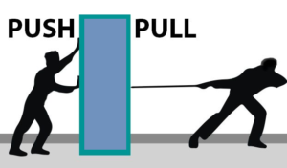
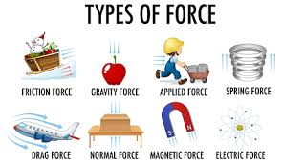
What is Force?
Definition: Force is a push or pull that changes or tends to change the state of rest or motion, or the shape of a body.
Equation: F=ma
SI Unit: Newton (N), CGS Unit: Dyne
Conversion: 1 N=105 dyne1\,N = 10^5\,dyne1N=105dyne

Slide 3
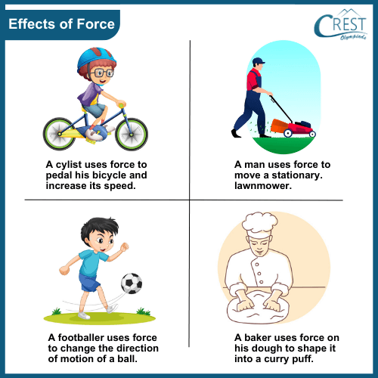
Effects of Force
Can move a stationary object
Can stop/slows a moving object
Can change the direction of motion
Can change shape of object
Examples: Bending spring, squeezing lemon, braking bike

Slide 4
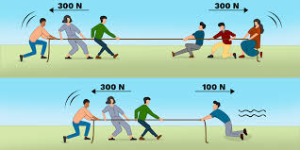
Balanced vs Unbalanced Forces
Balanced: No change in motion (e.g., book on table)
Unbalanced: Causes acceleration or change (e.g., pushing a cart)
Visuals: Tug of war, box resting, box accelerating

Slide 5
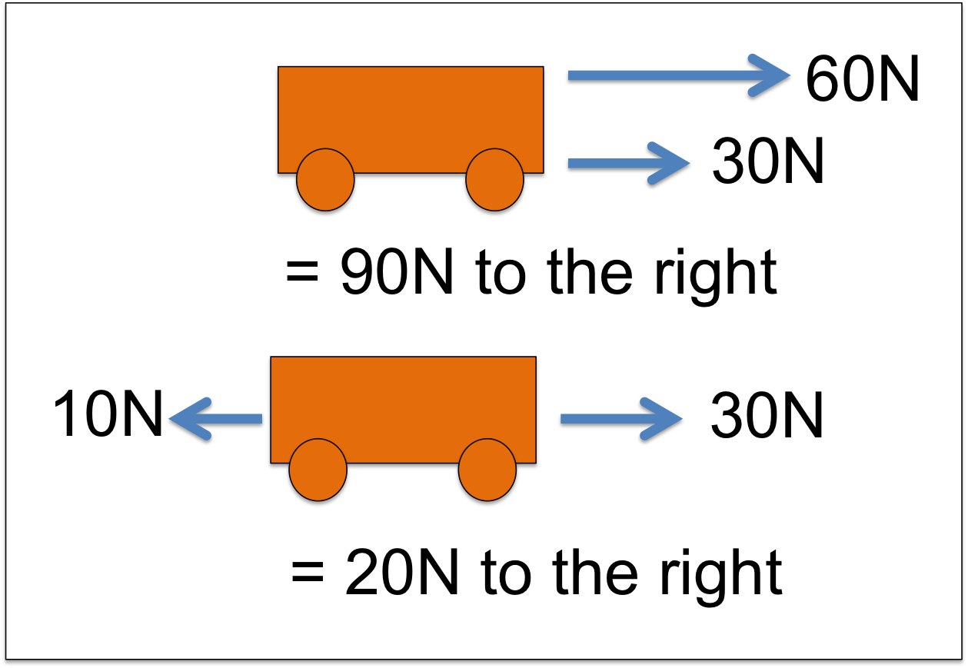
Resultant Force
The single force that has the same effect as a number of forces acting together.
If multiple forces act on a body, the net effect is calculated as the vector sum of all forces.
HOTS: "Can the resultant of two non-zero forces be zero?"

Slide 6
Simple case
Let’s say two forces F₁ and F₂​ act along the same line (e.g., left-right).
🔸 Case A: Same Direction
F_{resultant}= F₁ + F₂ ​ 👉 Both forces help each other.
🔸 Case B: Opposite Directions
F_{resultant}=∣ F₁ − F₂ ∣👉 Direction of resultant is toward the larger force.
🧠 Example:
A 10 N force to the right and 6 N to the left.
F_{resultant}=∣10−6∣=4 N to the rightF

Slide 7
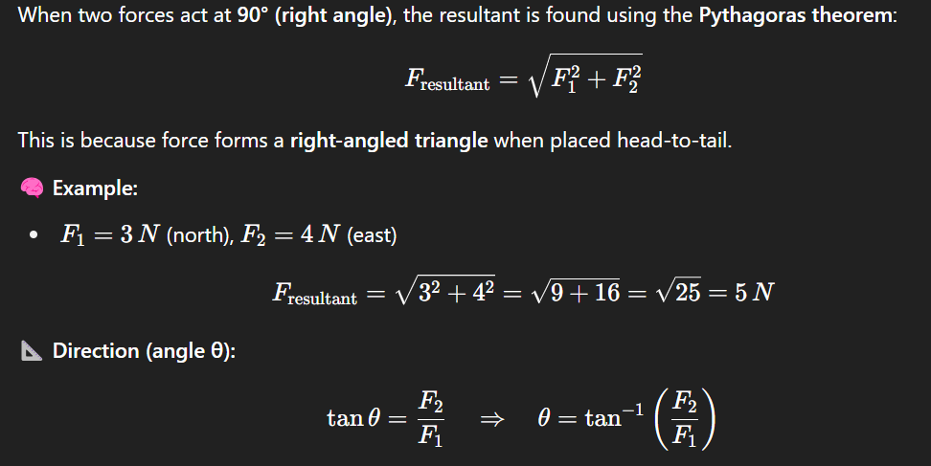
perpendicular

Slide 8
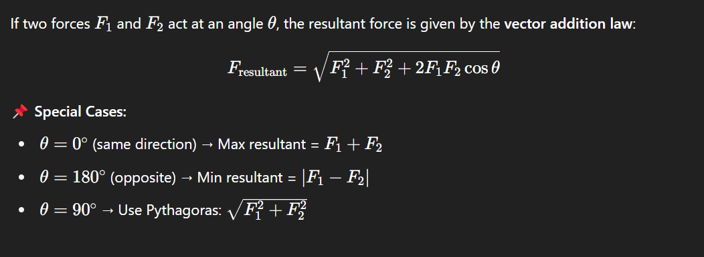
General case

Slide 9
Scalar vs vector
Quantity | Type | Example
Distance | Scalar | 10 m
Force | Vector | 5 N east
Speed | Scalar | 30 km/h
Velocity | Vector | 30 km/h north

Slide 10
Scalars have only magnitude
Vectors have magnitude + direction
If 5 N up and 5 N down → Resultant = 0 N (balanced forces)
A force of 10 N right and 4 N left → Resultant = 6 N right

Slide 11
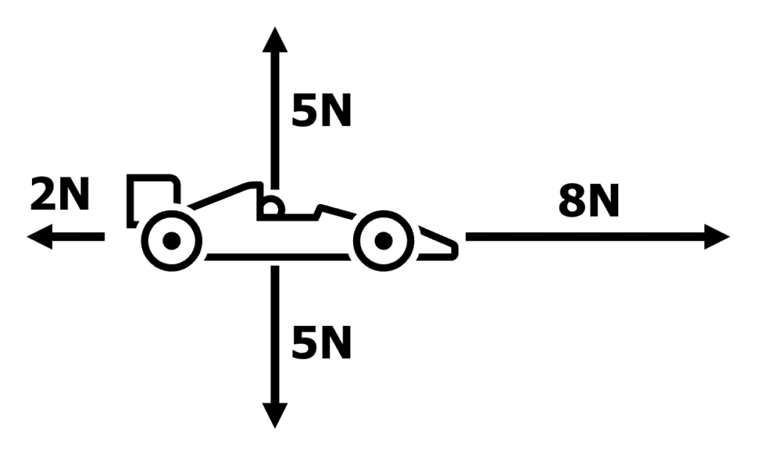

Slide 12
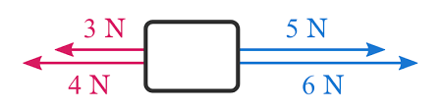

Slide 13
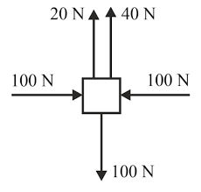

Slide 14
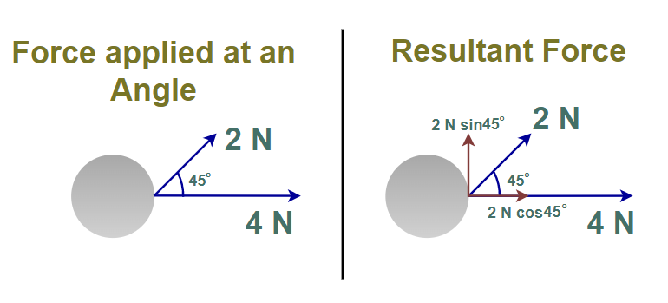
Direction?

Slide 15
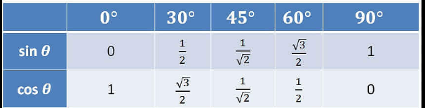
trigonometry

Slide 16
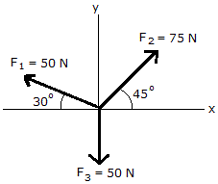

Slide 17
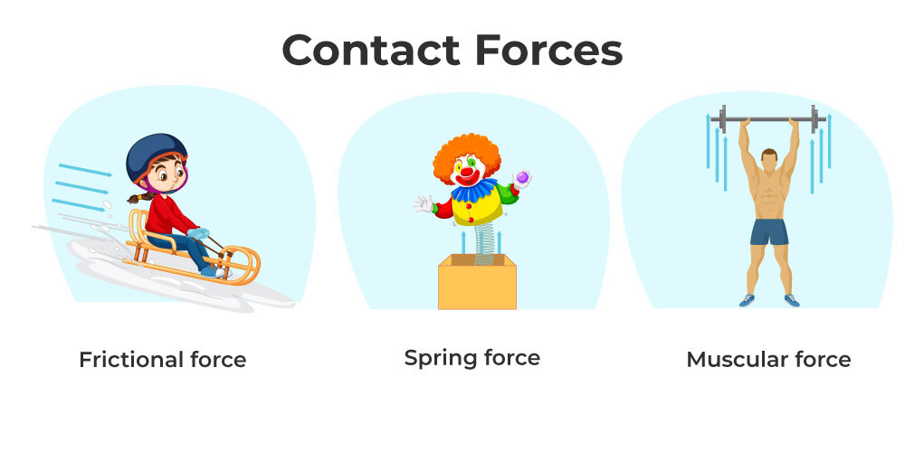
Contact Forces
Require physical contact
Types:
Muscular force
Frictional force
Normal force
Example: Walking, pushing cart, book on table

Slide 18
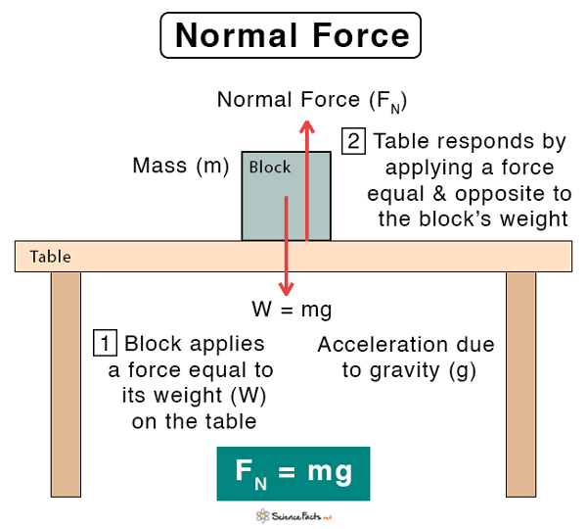
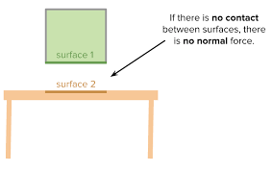
Normal force :
If contact forces between the bodies is perpendicular to the surface in contact, then the forces are known as normal forces.

Slide 19
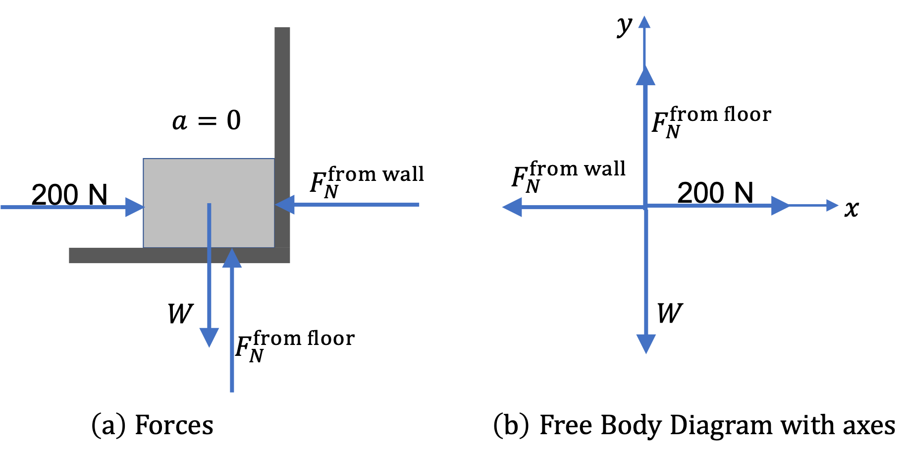

Slide 20
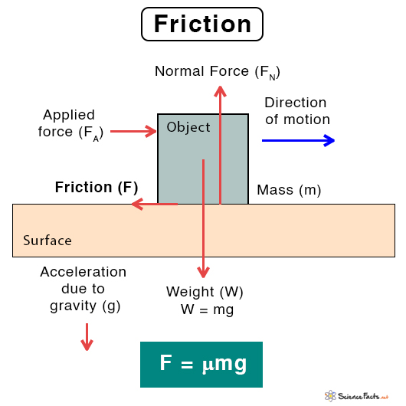
Force of friction
Two bodies placed in contact can also exert forces parallel to the surfaces in contact, such a force is called force of friction or simply friction. It always opposes relative motion of an object.

Slide 21
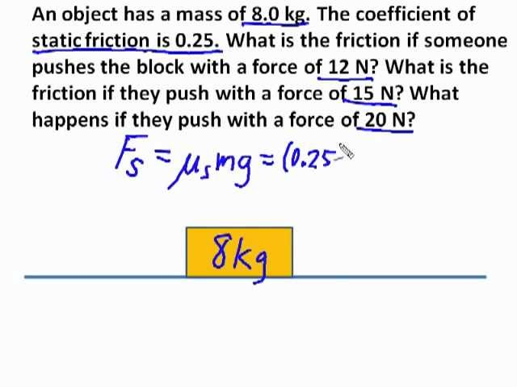

Slide 22
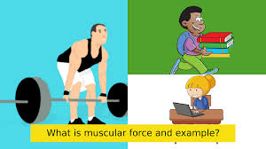
Muscular force
This is the force we can exert with our bodies by using our muscles, e.g. pull, push, kick, etc. Such forces are also called muscular forces. These are contact forces.

Slide 23
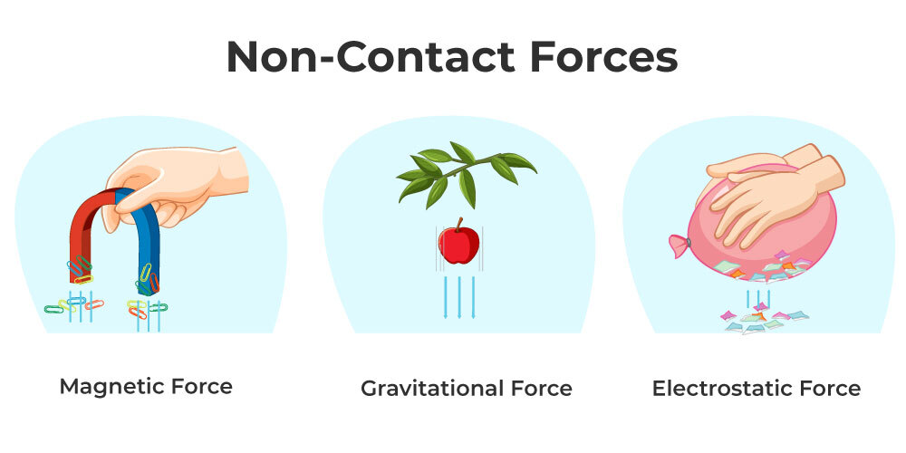
Non-Contact Forces
Do not require contact
Types:
Gravitational
Electrostatic
Magnetic
Visual: Iron nails near magnet, rubbed comb attracting paper

Slide 24
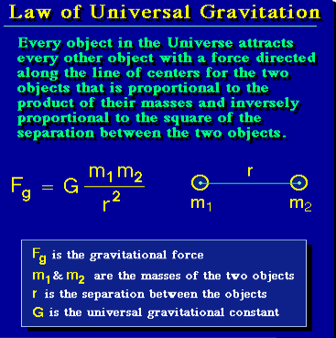
Gravitational Force & Weight
Newton said that every object in this universe attracts every other object with a certain force. The force with which two objects attract each other is called the force of gravitation. The force of gravitation acts even if the two objects are not connected by any means. If however, the masses of the objects are small, the force of gravitation between them is small and cannot be detected easily. The force of attraction between any two particles in the universe is called gravitation or gravitational force.

Slide 25
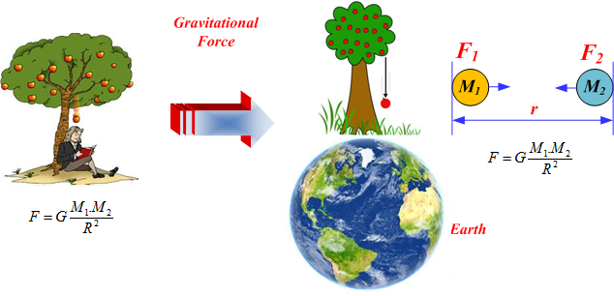
The earth attracts all the bodies towards its centre. The force exerted by the earth on the body is known as weight of the body or force of gravity. It acts in vertically downward direction. If mass of the body is m and acceleration due to gravity is g. Then force of gravity or weight = mg. The value of g is 9.8 m/s2. For a body moving downward, g is taken as positive while for a body moving upward, g is taken as negative.

Slide 26
The force due to gravity on a body of mass m at a place where acceleration due to gravity is g, is given as F = mg
Since the average value of g is 980 cms–2, 1 gf = 980 dyne Further, 1 kgf = 1000 gf To an approximation 1 kgf can be treated to be nearly equal to 10 N. Then 1 N = 0.1 kgf or 1 N = 100 gf.

Slide 27
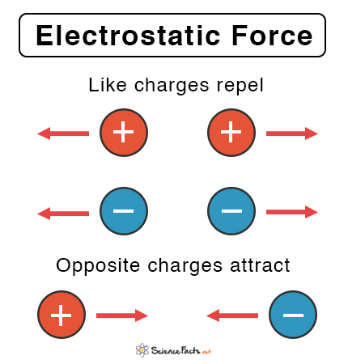
Electrostatic force
The force exerted by a charged body on another charged or uncharged body is known as electrostatic force. When a plastic comb is rubbed with silk, it can pick up small bits of paper . This is because the comb acquires an electric charge because of which it can exert a force called electrostatic force. Electrostatic force can also act from a distance and is therefore a non contact force. A body with electrostatic charge can either attract or repel another charged body. Electrostatic force is used to separate solid pollutant particles from smoke given out from factories.

Slide 28
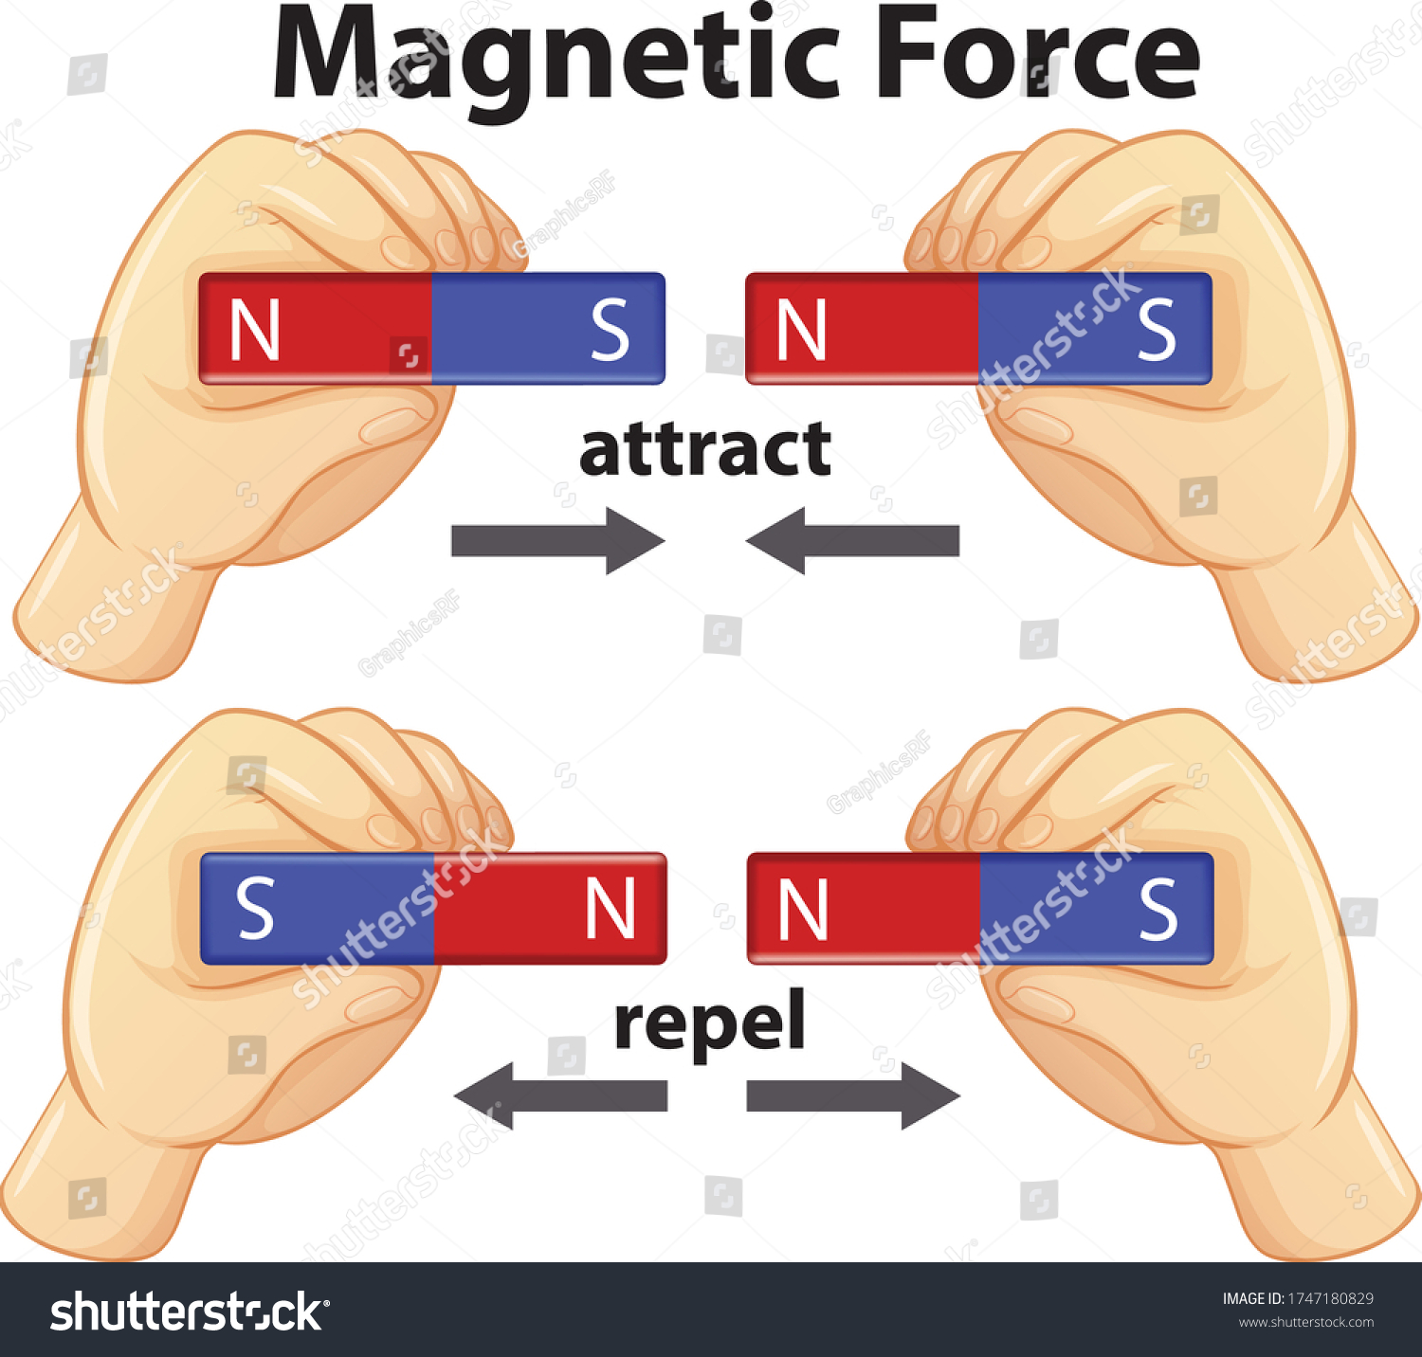
Magnetic force
A magnet attracts iron filings, nails and other objects made of iron, steel, nickel and cobalt . Magnets exert forces of attraction or repulsion on other magnets. An important feature of magnetic force is that it can act from a distance and is therefore a non–contact force.

Slide 29
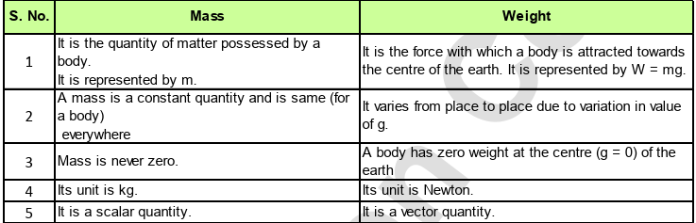

Slide 30
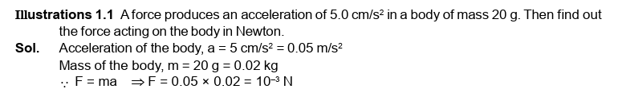

Slide 31
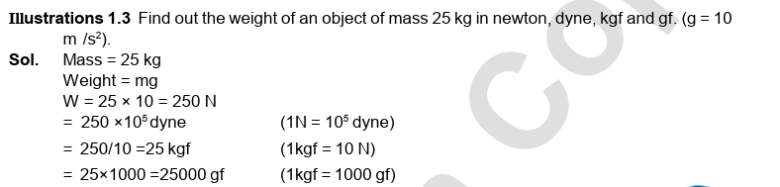

Slide 32
Extra info dump!
We know only four fundamental forces in the universe. They are gravitational force, electromagnetic force, weak force and strong interactions. We are familiar with the first two. Weak forces come into play during radioactivity. Strong interactions are responsible for holding the nucleus of an atom together.
All other forces are manifestations of these fundamental forces. For example, forces such as friction between bodies, muscular action, etc. viewed on an atomic scale arise chiefly from electrical attraction and repulsion of the electrons and nuclei making up the atoms of the material.

Slide 33
easy
Q1. Which combination of statements about force is correct? i. Force can change the direction of a moving object. ii. Force can only be exerted through contact. iii. Force can change the shape of an object. iv. Non-contact forces act only when there is physical touch. v. Friction is an example of contact force.
A. i, iii, v only B. ii, iv, v only C. i, ii, iv only D. All i, ii, iii, iv and v

Slide 34
easy
Q2. Which of the following pairs is correctly matched?
Force Type | Example
P → Contact | Q → Non-contact
Options: A. P – Friction, Q – Gravitational B. P – Magnetic, Q – Electrostatic C. P – Muscular, Q – Friction D. P – Magnetic, Q – Gravitational

Slide 35
medium
Q3. A 10 N force is applied to the right and a 4 N force is applied to the left on the same object. The resultant force is: A. 14 N right B. 6 N right C. 6 N left D. 14 N left

Slide 36
medium
Q4. Which combination of statements is correct regarding friction? i. It is a non-contact force. ii. It always opposes motion. iii. It helps us walk. iv. Friction can cause heating. v. It cannot be reduced in machines.
A. ii, iii, iv only B. i, ii, iii only C. ii, iv, v only D. All i, ii, iii, iv and v

Slide 37
tough
Q5. A body of mass 4 kg is moving with acceleration 2.5 m/s². What is the applied force?
A. 10 N B. 6.5 N C. 1.6 N D. 12.5 N

Slide 38
tough
Q6. Which of the following combinations is correct?
Quantity | Scalar or Vector | SI Unit
P → Force | Q → Acceleration | R → Newton
A. P – Scalar, Q – Scalar, R – Dyne B. P – Vector, Q – Vector, R – Newton C. P – Scalar, Q – Vector, R – Dyne D. P – Vector, Q – Scalar, R – Newton

Slide 39
hots
Q7. Two forces act on a body at right angles: 6 N north and 8 N east. What is the magnitude of the resultant force?
A. 10 N B. 14 N C. 2 N D. 48 N

Slide 40
hots
Q8. Which combination of statements is correct for vector addition of force?
i. Force is a vector quantity. ii. Direction is not required in vector addition. iii. Two forces in opposite directions can cancel each other. iv. Net force is a scalar sum of all forces. v. When two equal forces act at 90°, resultant is √2 times one of them.
A. i, iii, v only B. ii, iv, v only C. i, ii, iii only D. All i, ii, iii, iv and v

Slide 41
🟢 EASY LEVEL
Q1. A → i, iii, v only Q2. A → P – Friction (contact), Q – Gravitational (non-contact)

Slide 42
Q3. B → 10 N – 4 N = 6 N right Q4. A → ii (opposes motion), iii (helps walk), iv (causes heat)

Slide 43
Q5. A → F = ma = 4 × 2.5 = 10 N Q6. B → Force and acceleration are vectors, SI unit of force is Newton

Slide 44
Q7. A → Resultant = √(6² + 8²) = √(36 + 64) = √100 = 10 N Q8. A → i (force is vector), iii (opposite forces can cancel), v (resultant of two equal forces at 90° is √2F)

